Slide 1

Accelerating a Convolutional Neural Network
Ezekiel Tay z5378748
Kenneth Law z5363506
Sicheng Jin z5317861

Slide 2
Presentation scope
Motivation
What is a CNN?
Training the Model
Components of CNN & Pseudo Code for prediction process
C-code for prediction process
Methods of accelerating the prediction process

Slide 3
Motivation
CNN computation:
CNN convolution layers often dominate the runtime.
E.g. 2012 Imagenet’s convolution layers accounted for over 90% of runtime [1]
Why FPGAs?
Exploit massive parallelism to accelerate the convolution process
Potential for higher energy efficiency compared to GPUs
Suits the need for real-time inference with low energy cost
[1] Cong, J. and Xiao, B., 2014, September. Minimizing computation in convolutional neural networks. In International conference on artificial neural networks (pp. 281-290).

Slide 4
What is a Convolutional Neural Network (CNN) ?
A Convolutional Neural Network (CNN) is a class of neural networks that specializes in processing data that has a grid-like topology, such as an image.
Scope of Project:
~ A toy CNN in the context of recognising digits from the MNIST dataset
~ Accelerating the prediction process

Slide 5

What is in the convolution layer?
Purpose:
To extract spatial features from images
Main operations:
A sliding window operation (Cross-correlation)
Matrix multiplication corresponding to values in input (f) and kernel (g)
Multiply-Accumulate (MAC)
Bias addition
Activation Function
Often the ReLU function (max (0, x))
Computational Complexity: $C^{2}K^{2}HW$
(C = # Kernels, K = Kernel size, H and W = output feature map height and width)
Visuals from: Wikipedia contributors. "Convolution." Wikipedia, The Free Encyclopedia. Wikipedia, The Free Encyclopedia. https://en.wikipedia.org/wiki/Convolution

Slide 6
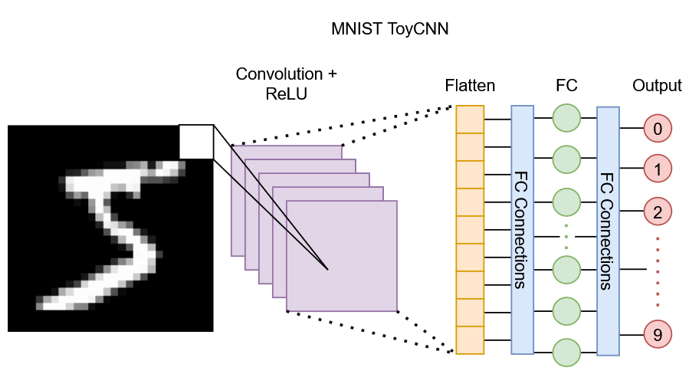
ToyCNN
1 Convolution + ReLU layer:
8 Kernels of size 3x3
Valid convolution (No padding)
Results in 26x26 output per kernel
Flatten Layer
Flattens the 8 kernels
Results in 26x26x8 1d array (5,408)
Fully Connected (FC) Layer
5,408 inputs
10 outputs (Predicted outputs) of digits 0 to 9
54,080 connections total

Slide 7
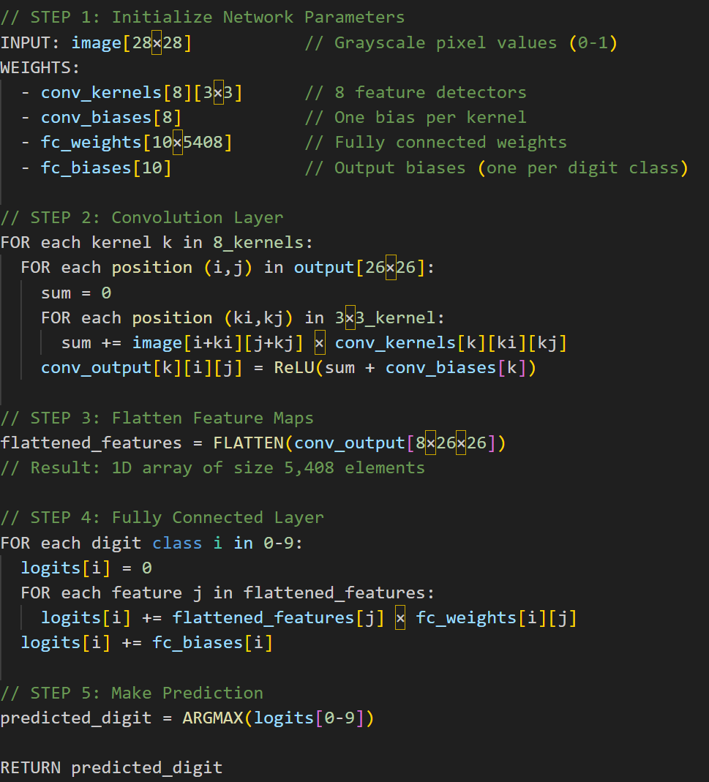
Pseudocode

Slide 8
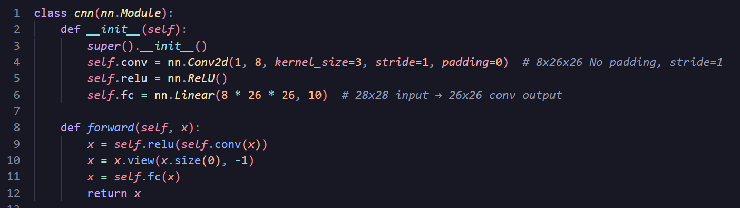
Training ToyCNN
Used the PyTorch library to quickly train the CNN on the GPU
After 25 training epochs:
Training set (60k samples):
Accuracy: 99.88%
F1-Score: 0.9987
Test set (10k samples):
Accuracy: 97.82%
F1-Score: 0.9780

Slide 9
Code Demonstration
Run trainer.ipynb
Possible show example images from MNIST dataset
Show model weights in “weights” directory
Compile & run C code

Slide 10
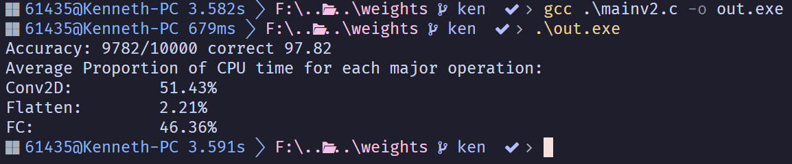
ToyCNN’s Inference Performance
3 main operations:
2D Convolution
Flatten
FC
Conv2D and FC layers dominate runtime, however:
FC runtime is large due to the simple architecture of ToyCNN
In proper, large scale CNNs, the Conv2D proportion quickly dominates

Slide 11
Possible Optimisation Considerations
Hardware-level optimisations:
Data parallelism
Memory access patterns
Line buffering
Loop Unrolling
Array partitioning/Reshaping
Burst transfers
Ping-Pong buffers / Double buffers
Task parallelism
MAC parallelization
MAC units or systolic array-like
Function inlining
Dataflow structures

Slide 12
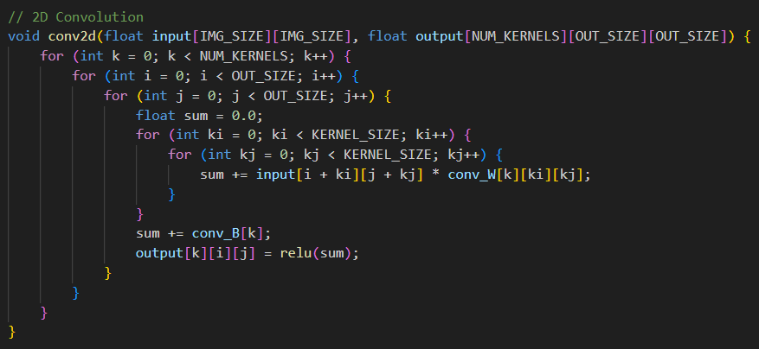
Array Partitioning

Slide 13
Array Partitioning
Array for Input and Output will be partitioned completely.
Data will be stored in Flip Flops
All elements in the array can be accessed concurrently (Avoids case of only 2 read or writes if BRAM is used)

Slide 14
Loop Unrolling
Notes:
Multiplication can be unrolled. Adder tree to sum the results.

Slide 15
Loop Unrolling
Unrolling of i and j loop (Each output from each pixel of the image is independent of each other)
Possible to unroll the outer most loop (k), this means 8 kernel convolutions are running at the same time
Determine if there is adequate resources to accommodate this modification (Also not suitable for scaling)
The inner ki and kj loop have the variable “sum” as a data dependency
Notes:
Add image here for reference

Slide 16
Applying HW optimisations
Notes:
Add image here for reference

Slide 17
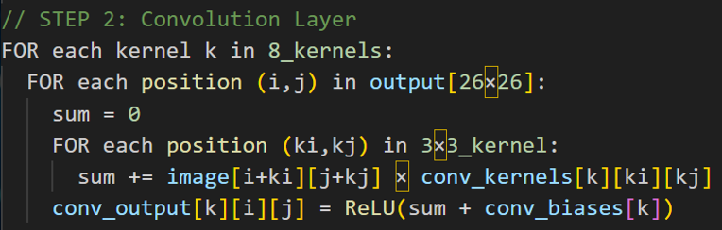
Speeding up the dot product
For each of the 8 kernels (3x3):
9 multiplications (kernel weights * pixels)
Sum the 9 products -> 1 scalar output
Add the kernel bias then reLU
Slide to next position
For a 28x28 image, this happens 676 times!
6,084 multiplications (48,672 for 8 kernels)
6,084 additions (48,672 for 8 kernels)
97,344 operations for each image!

Slide 18
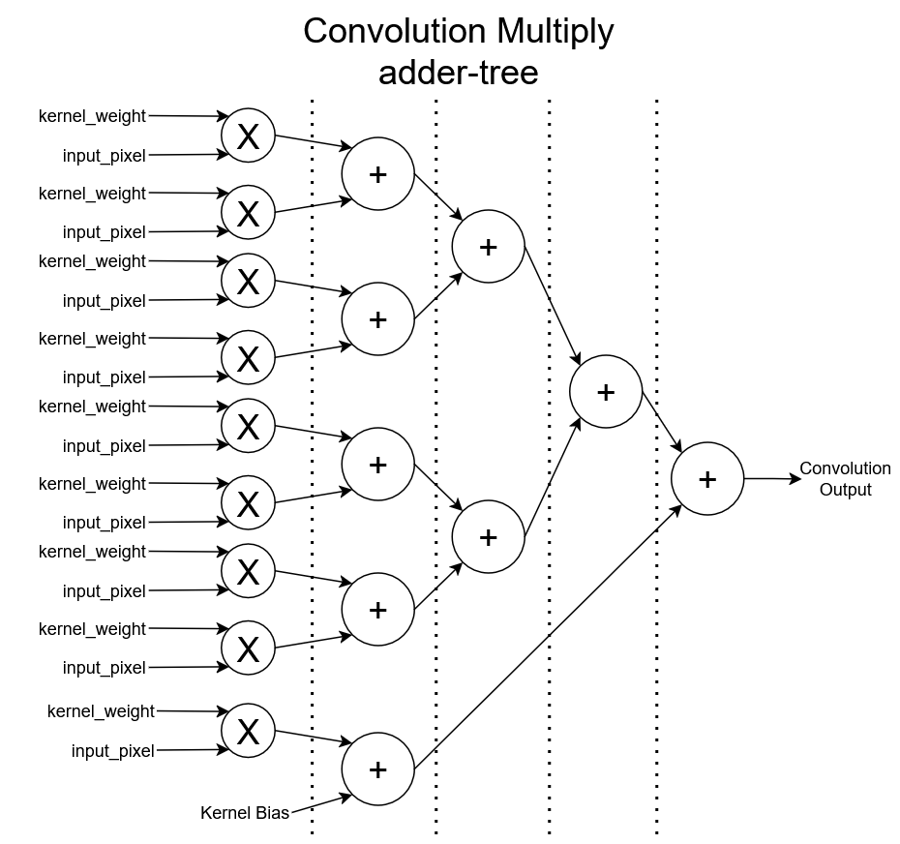
Conv Multiply Accumulate unit (CMAC)
For a dot product/position for a kernel:
Multiply in parallel
Accumulate via adder trees
Reduce 9 cycles of mult to 1 cycles
Reduce 9 cycles of addition to 4 cycles
Ceil(log2(9)) = 4 cycles
May use less cycles if HLS can compute multiple tree levels in a single cycle.

Slide 19
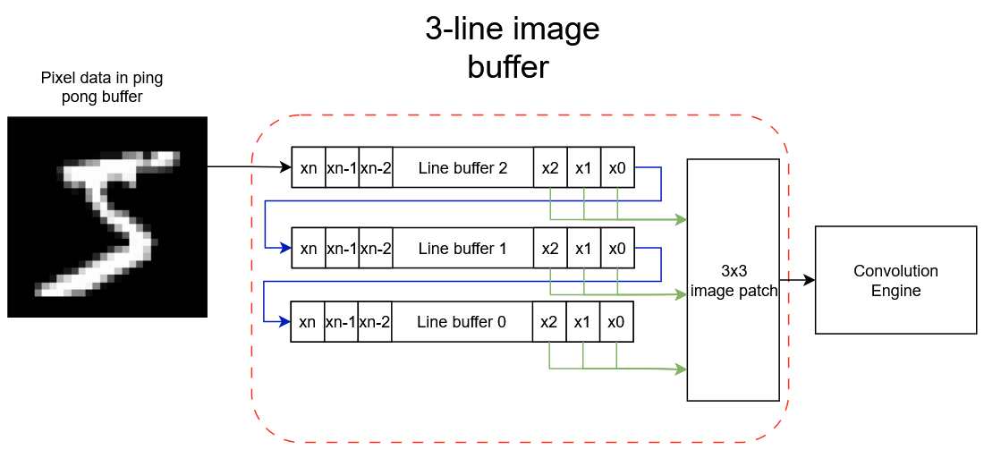
Slide the image instead of kernels
Image pixels as a sliding window:
Slide the image across the kernels instead of sliding the kernels
Via a 3-line image buffer
Removes each CMAC unit needing logic for sliding the kernel across the image
Allows storing the kernel weights/biases in registers (much cheaper)
Image data streamed from ping pong buffer
While one image is streamed into the line buffer and processed another image is loaded into the other buffer
Potentially removing stalls and memory latency

Slide 20
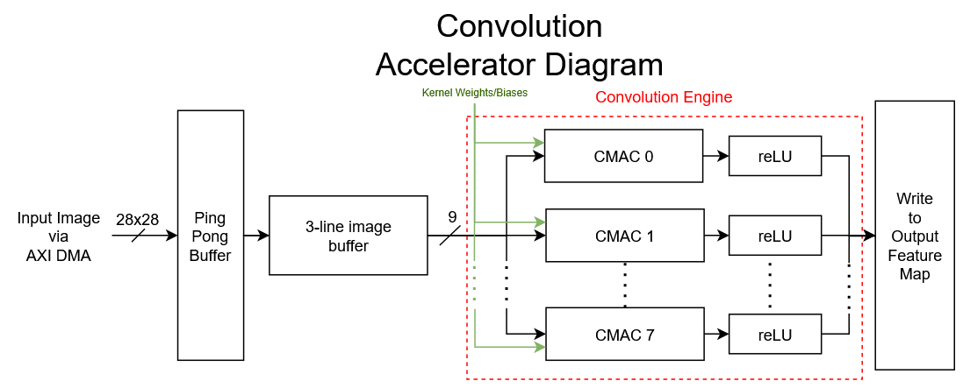
Planned Accelerator Design

Slide 21
Software-level optimisations
FFT-based Convolution
Winograd Convolution
Switch from floats to fixed point

Slide 22
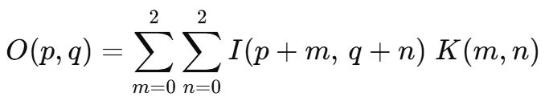
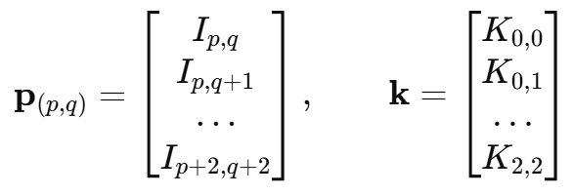

FFT-based Convolution
Convolution can be expressed as:
We can Run a 2-D FFT on the padded image → FFT(I).
Pre-compute the 32 × 32 FFT of the padded kernel → FFT(K).

Slide 23
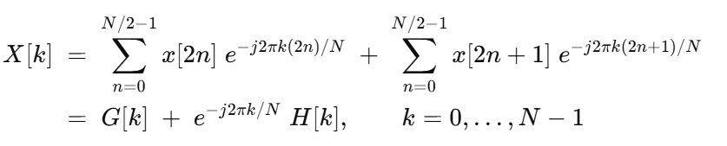
How is FFT performed on the input / kernel?
A kernel represents a pattern of pixel values
When we slide the kernel over the input, the kernel captures how much of its own pixel pattern is present in the input pixels.
Every k represents a stride (~frequency) in the pattern.

Slide 24
Limits of Using FFT
Each forward/inverse FFT costs roughly N*log_2(N) ops. However, at small scales it is still much more expensive than direct convolution
For our 3 × 3 kernels the direct method is already cheaper than adding two 32 × 32 FFTs.
We must pad both operands to at least (I+K−1)×(I+K−1), then usually to the next power of two. The zero area increases area usage without adding any efficiency.

Slide 25
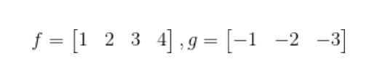
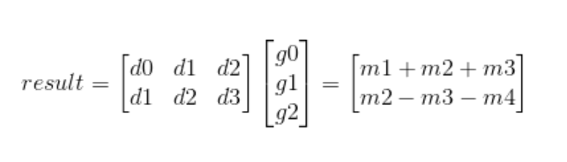
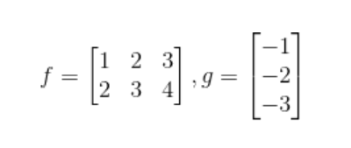
Winograd Convolution
A 3 × 3 spatial convolution normally needs 9 multiplies every time you place the kernel.
If we pre-add the pixels in a very specific way and post-add the results in a specific way, we can do the same with 4 multiplies.
However, we need to change stride to 2

Slide 26

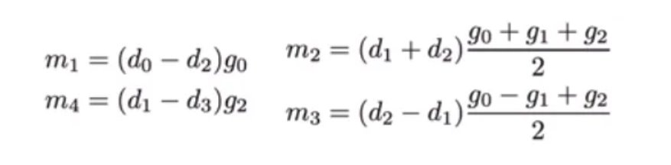
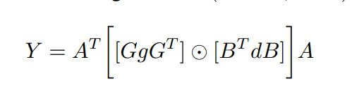







Winograd Convolution
Those adds/shifts are collected into constant matrices.
Multiplying an input matrix by B^T is just a bunch of adds and subtractions wired together.
G with the kernel and A^T on the way out.
Reduces ~50% multiplication, hence the number of DSPs

Slide 27
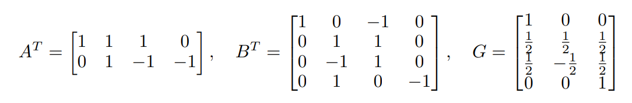

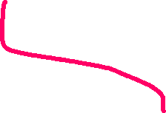







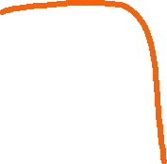
Winograd Convolution
For filter size = 3*3, output 2*2, input 4*4, the optimal matrices are:
We can pre-determine and store the results of a large part of matrix calculation: G*g known
B^T * {d0,d1,d2,d3} = {(d0-d2),(d1+d2),(d2-d1),(d1-d3)}
G*g = {g0, (g0+g1+g2)/2, (g0-g1+g2)/2}

Slide 28
Floating to Fixed-points
We can also change the number representation
Utilisation will reduce if we use fixed-points instead of floating
Accuracy might be affected
But given our small network size, it could be implemented

Slide 29
Project timeline
Legend
 | Dateline
 | To-be-completed
Term 3
 | Week
ACTIVITY | 6 | 7 | 8 | 9 | 10
Complete initial investigation, pseudo code & c-code
Upload code onto Kria Board + Implement planned HW design
Loop unrolling + array partitioning + pipelining + Quantisation
Documentation
Final Demo
Notes:
Add week 6 investigation and performance

Slide 30
Risk & Contingencies
May face a challenge uploading code onto the Kria Board (Start in week 7, reach out to tutors if needed)
Implementing several methods of acceleration simultaneously leads to unexpected outcomes & problems integrating them together – More time to debug (Aim to complete the acceleration by week 8, week 9 as buffer)

Slide 31
Roles
Member | Role
Ezekiel | Python code for training & selecting test data C – code for predicting image Loop Unrolling & Array partitioning
Ken | Modified Python code for training & selecting test data Modified C – code for predicting image Implement planned HW design 3-line buffer
Stefan | Uploading code to board Pipelining AP_fixed instead of floats Winograd

Slide 32
The End

